Slide 1



TÍNH TOÁN ĐA PHƯƠNG TIỆN
INTRODUCTION MULTIMEDIA COMPUTING
NÉN DỮ LIỆU
Notes:
Mục tiêu của môn học

Slide 2
Nội dung
Khái niệm nén dữ liệu (compression)
Nén mất thông tin (lossy compression)
Nén không mất thông tin (lossless compression)
Notes:
1. What is the problem?
2. Why is it interesting and important?
3. Why is it hard? (e.g., why do naive approaches fail?)
4. Why hasn't it been solved before? (or, what's wrong with previous proposed solutions? How does ours differ?)
5. What are the key components of our approach and results? Also include any specific limitations. A final paragraph or subsection: “Summary of Contributions”. It should list the major contributions in bullet form, mentioning in which sections they can be found.

Slide 3
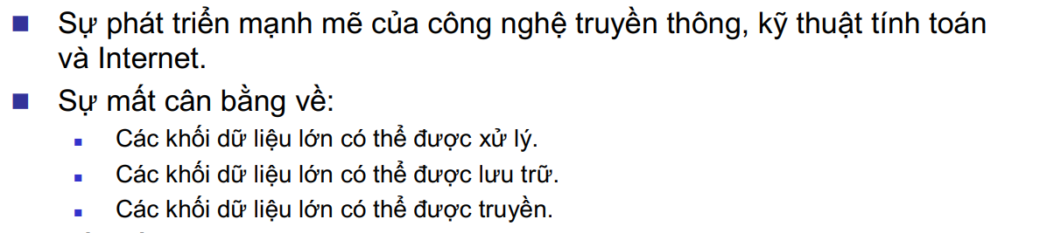
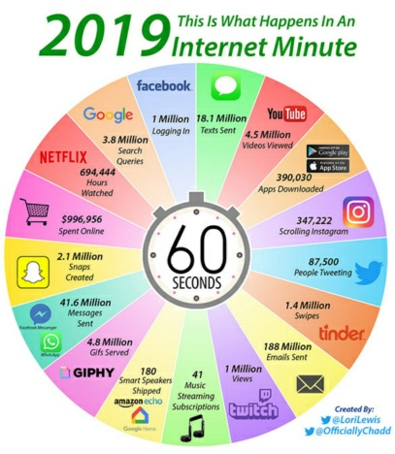
Nhu cầu về nén dữ liệu
Notes:
1. What is the problem?
2. Why is it interesting and important?
3. Why is it hard? (e.g., why do naive approaches fail?)
4. Why hasn't it been solved before? (or, what's wrong with previous proposed solutions? How does ours differ?)
5. What are the key components of our approach and results? Also include any specific limitations. A final paragraph or subsection: “Summary of Contributions”. It should list the major contributions in bullet form, mentioning in which sections they can be found.

Slide 4
Nhu cầu về nén dữ liệu
Notes:
1. What is the problem?
2. Why is it interesting and important?
3. Why is it hard? (e.g., why do naive approaches fail?)
4. Why hasn't it been solved before? (or, what's wrong with previous proposed solutions? How does ours differ?)
5. What are the key components of our approach and results? Also include any specific limitations. A final paragraph or subsection: “Summary of Contributions”. It should list the major contributions in bullet form, mentioning in which sections they can be found.

Slide 5
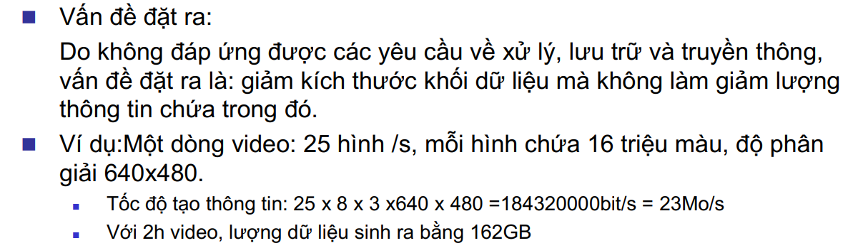
Nhu cầu về nén dữ liệu
Notes:
1. What is the problem?
2. Why is it interesting and important?
3. Why is it hard? (e.g., why do naive approaches fail?)
4. Why hasn't it been solved before? (or, what's wrong with previous proposed solutions? How does ours differ?)
5. What are the key components of our approach and results? Also include any specific limitations. A final paragraph or subsection: “Summary of Contributions”. It should list the major contributions in bullet form, mentioning in which sections they can be found.

Slide 6
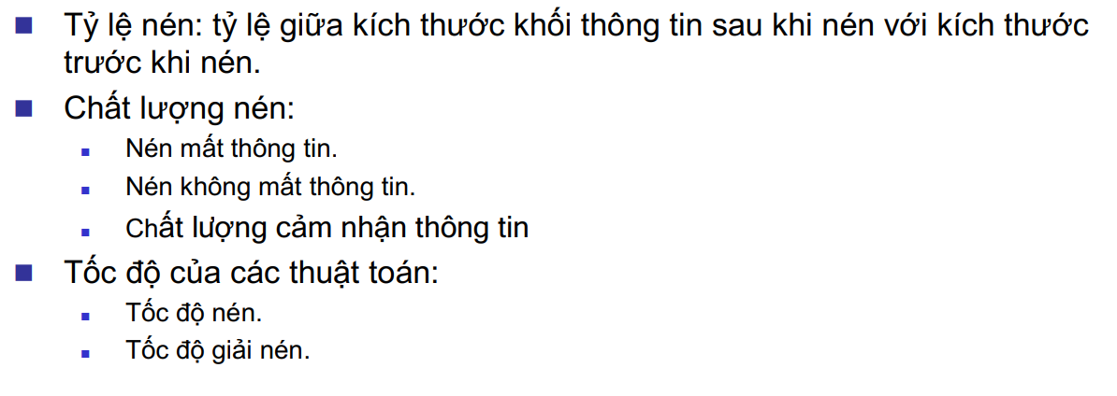
Các tiêu chuẩn trong nén dữ liệu
Notes:
1. What is the problem?
2. Why is it interesting and important?
3. Why is it hard? (e.g., why do naive approaches fail?)
4. Why hasn't it been solved before? (or, what's wrong with previous proposed solutions? How does ours differ?)
5. What are the key components of our approach and results? Also include any specific limitations. A final paragraph or subsection: “Summary of Contributions”. It should list the major contributions in bullet form, mentioning in which sections they can be found.

Slide 7
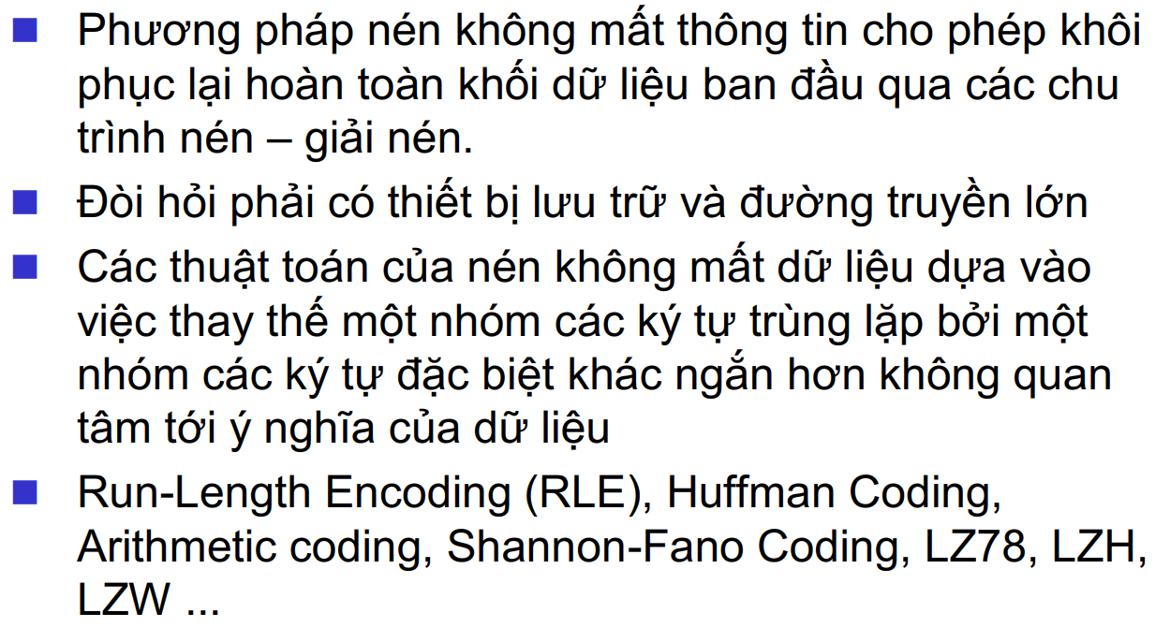
Nén không mất thông tin
Notes:
1. What is the problem?
2. Why is it interesting and important?
3. Why is it hard? (e.g., why do naive approaches fail?)
4. Why hasn't it been solved before? (or, what's wrong with previous proposed solutions? How does ours differ?)
5. What are the key components of our approach and results? Also include any specific limitations. A final paragraph or subsection: “Summary of Contributions”. It should list the major contributions in bullet form, mentioning in which sections they can be found.

Slide 8
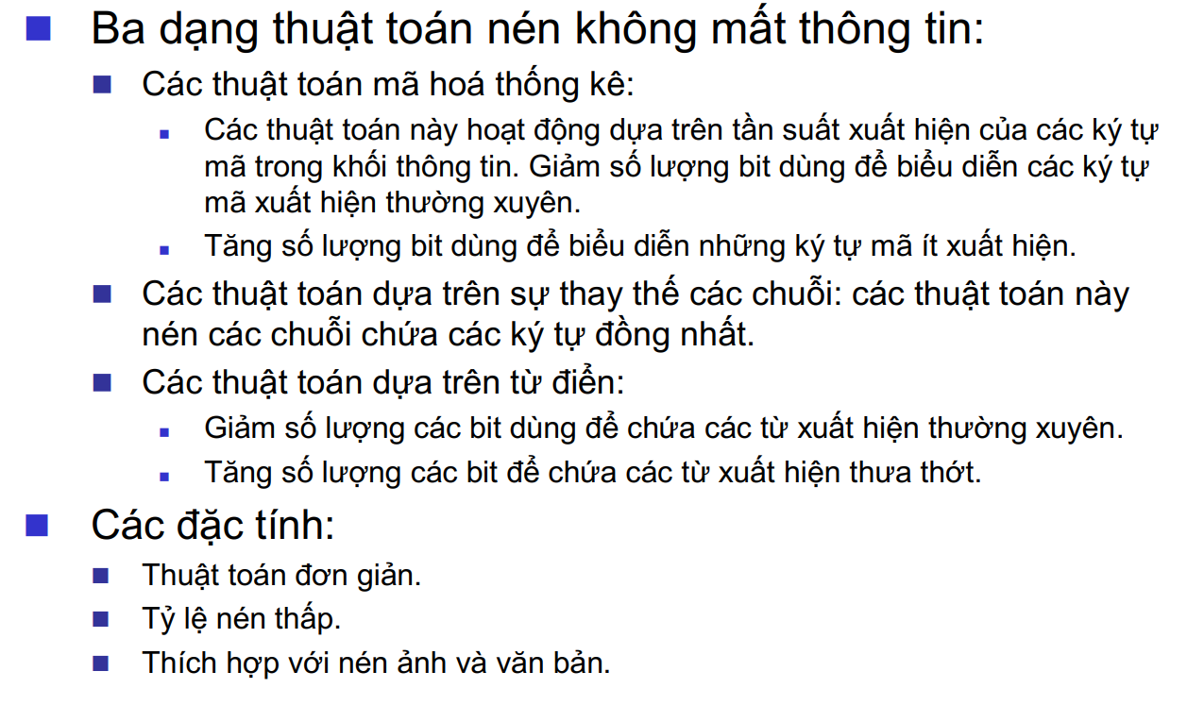
Nén không mất thông tin
Notes:
1. What is the problem?
2. Why is it interesting and important?
3. Why is it hard? (e.g., why do naive approaches fail?)
4. Why hasn't it been solved before? (or, what's wrong with previous proposed solutions? How does ours differ?)
5. What are the key components of our approach and results? Also include any specific limitations. A final paragraph or subsection: “Summary of Contributions”. It should list the major contributions in bullet form, mentioning in which sections they can be found.

Slide 9
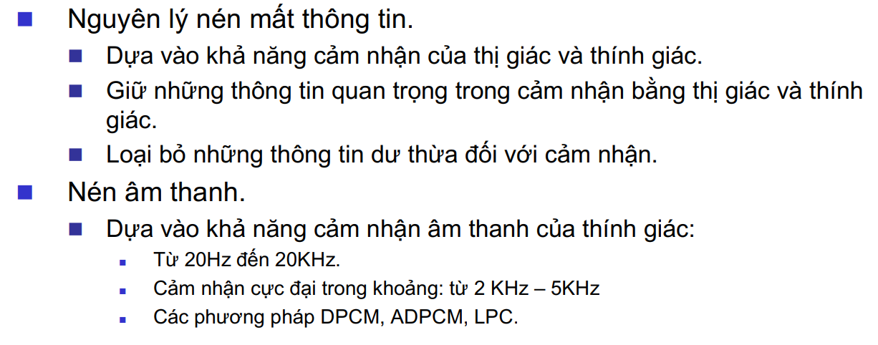
Nén mất thông tin
Notes:
1. What is the problem?
2. Why is it interesting and important?
3. Why is it hard? (e.g., why do naive approaches fail?)
4. Why hasn't it been solved before? (or, what's wrong with previous proposed solutions? How does ours differ?)
5. What are the key components of our approach and results? Also include any specific limitations. A final paragraph or subsection: “Summary of Contributions”. It should list the major contributions in bullet form, mentioning in which sections they can be found.

Slide 10
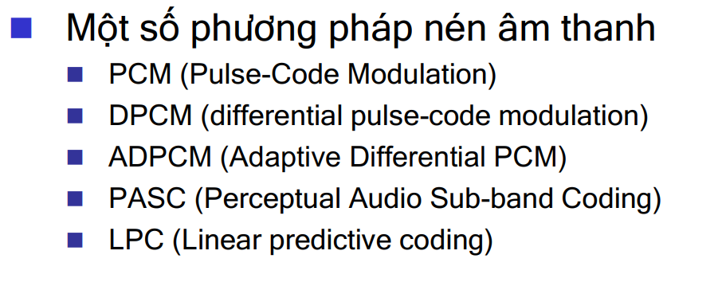
Nén mất thông tin
Notes:
1. What is the problem?
2. Why is it interesting and important?
3. Why is it hard? (e.g., why do naive approaches fail?)
4. Why hasn't it been solved before? (or, what's wrong with previous proposed solutions? How does ours differ?)
5. What are the key components of our approach and results? Also include any specific limitations. A final paragraph or subsection: “Summary of Contributions”. It should list the major contributions in bullet form, mentioning in which sections they can be found.

Slide 11
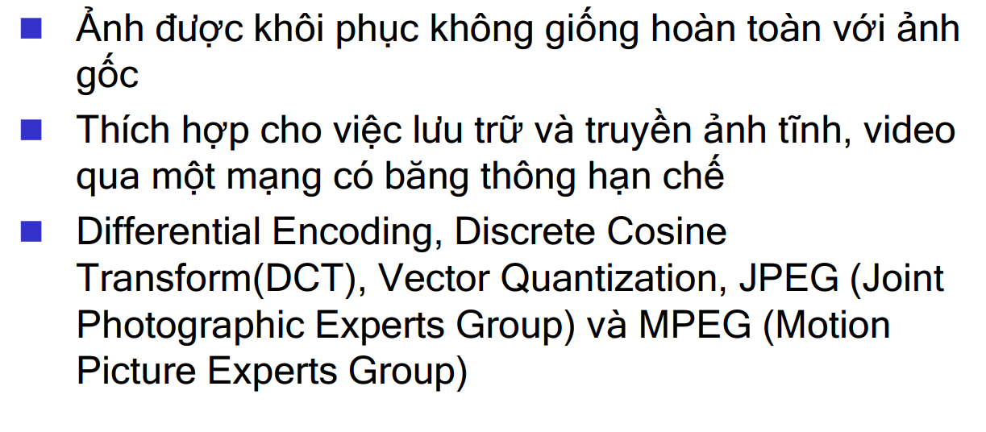
Nén ảnh
Notes:
1. What is the problem?
2. Why is it interesting and important?
3. Why is it hard? (e.g., why do naive approaches fail?)
4. Why hasn't it been solved before? (or, what's wrong with previous proposed solutions? How does ours differ?)
5. What are the key components of our approach and results? Also include any specific limitations. A final paragraph or subsection: “Summary of Contributions”. It should list the major contributions in bullet form, mentioning in which sections they can be found.

Slide 12
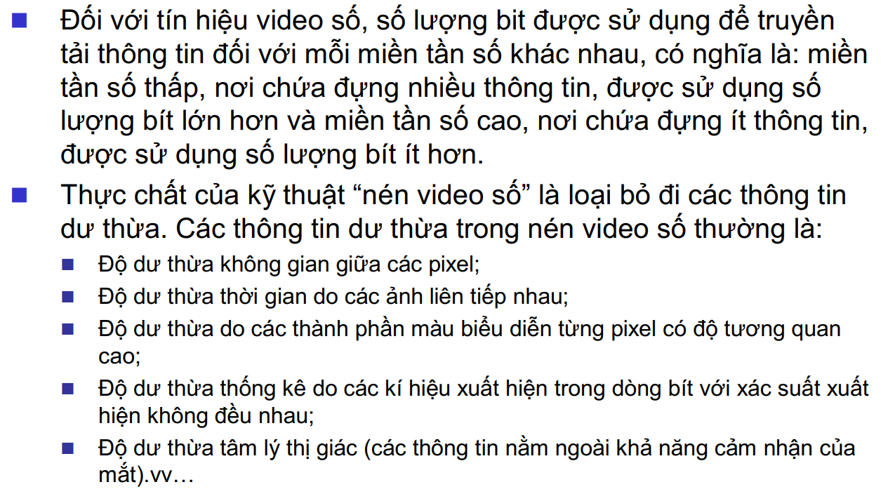
Nén video
Notes:
1. What is the problem?
2. Why is it interesting and important?
3. Why is it hard? (e.g., why do naive approaches fail?)
4. Why hasn't it been solved before? (or, what's wrong with previous proposed solutions? How does ours differ?)
5. What are the key components of our approach and results? Also include any specific limitations. A final paragraph or subsection: “Summary of Contributions”. It should list the major contributions in bullet form, mentioning in which sections they can be found.

Slide 13
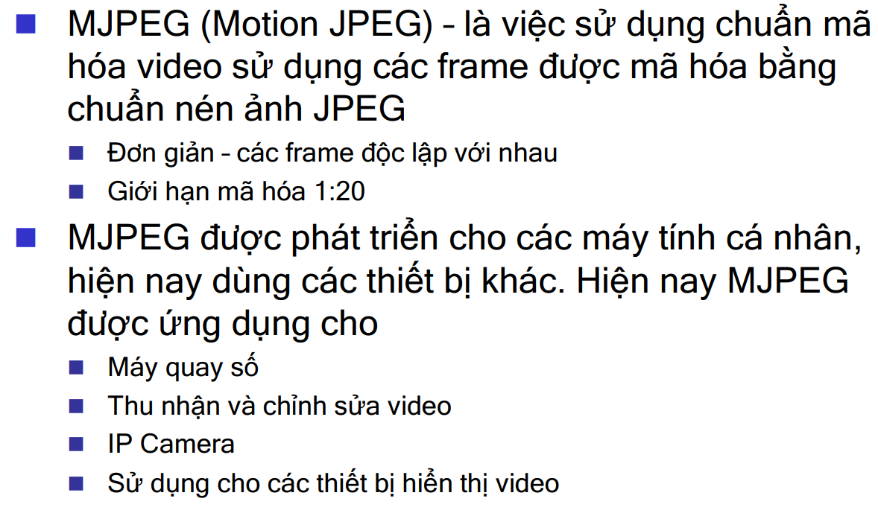
Nén video
Notes:
1. What is the problem?
2. Why is it interesting and important?
3. Why is it hard? (e.g., why do naive approaches fail?)
4. Why hasn't it been solved before? (or, what's wrong with previous proposed solutions? How does ours differ?)
5. What are the key components of our approach and results? Also include any specific limitations. A final paragraph or subsection: “Summary of Contributions”. It should list the major contributions in bullet form, mentioning in which sections they can be found.

Slide 14
Tài liệu tham khảo
http://ceng460.cankaya.edu.tr/course.php?page=Syllabus
https://www4.comp.polyu.edu.hk/~cskchung/COMP319/
Slide môn Đa Phương Tiện, Đại Học Bách Khoa Hà Nội

Slide 15


